Slide 1
Workshop 1
Grant Adams

Slide 2
Base R
Installing packages can be done using the install.packages function:
install.packages("mgcv")
Reading data can be done using the read.csv function
mydata <- read.csv("mack.csv")
Excel files can also be read in using the readxl package
install.packages("readxl") library(readxl) readxl::read_xlsx("excelfile.xlsx")

Slide 3
Simulating data

Slide 4
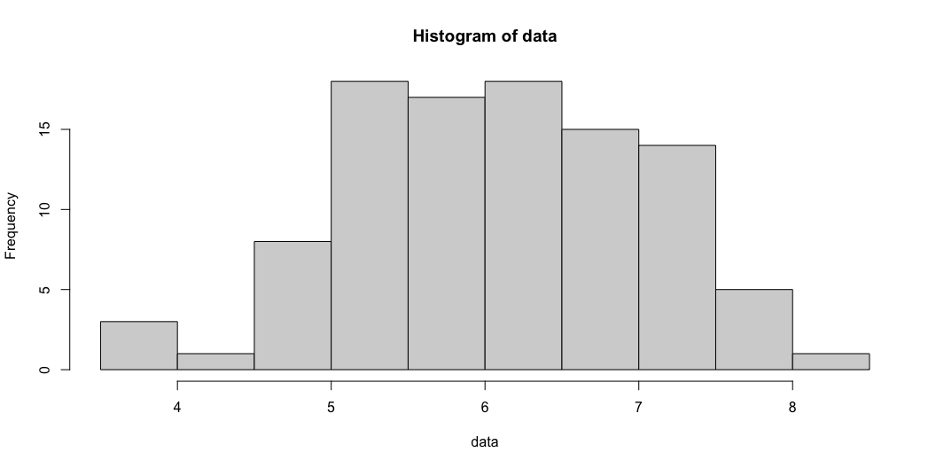
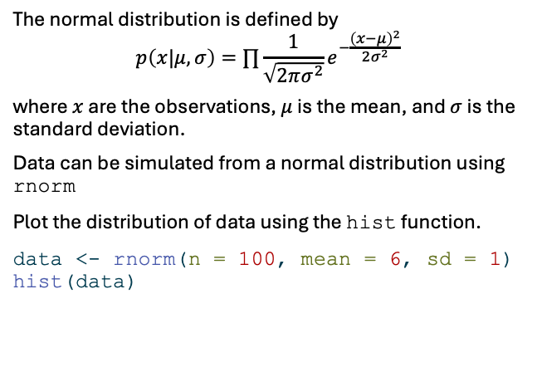
Normal distribution (1)
The normal distribution is defined by
$$p\left(x|μ,σ\right)=∏\frac{1}{\sqrt{2πσ^{2}}}e^{−\frac{{\left(x−μ\right)}^{2}}{2σ^{2}}}$$
where $x$ are the observations, $μ$ is the mean, and $σ$ is the standard deviation.
Data can be simulated from a normal distribution using rnorm
Plot the distribution of data using the hist function.
data <- rnorm(n = 100, mean = 6, sd = 1) hist(data)

Slide 5
Normal distribution (2)
The probability density is specified by dnorm.
We also use it as the likelihood function to estimate parameters
dnorm(0, mean = 6, sd = 1)
[1] 6.075883e-09
dnorm(6, mean = 6, sd = 1)
[1] 0.3989423

Slide 6
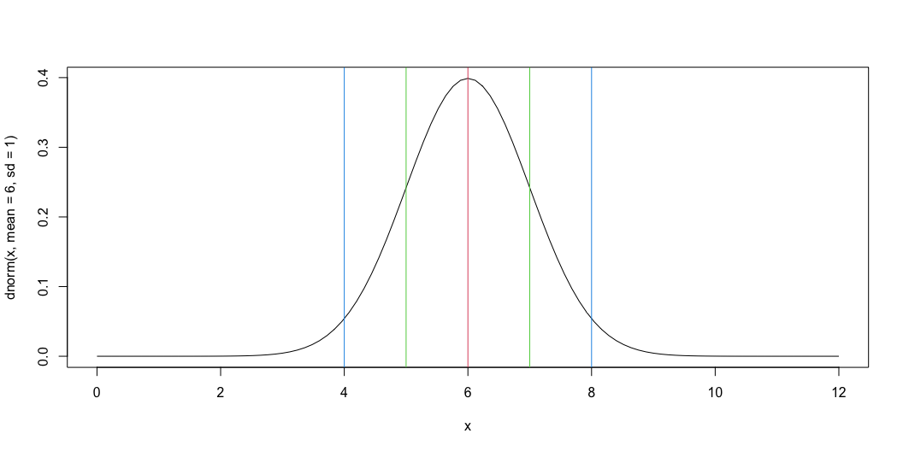
Normal distribution (3)
we can use the curve function to plot the probability density:
curve(dnorm(x, mean = 6, sd = 1), from = 0, to = 12) abline(v = 6, col = 2) # ~ 68% of probability abline(v = 5, col = 3) abline(v = 7, col = 3) # ~95% of probability abline(v = 4, col = 4) abline(v = 8, col = 4)

Slide 7
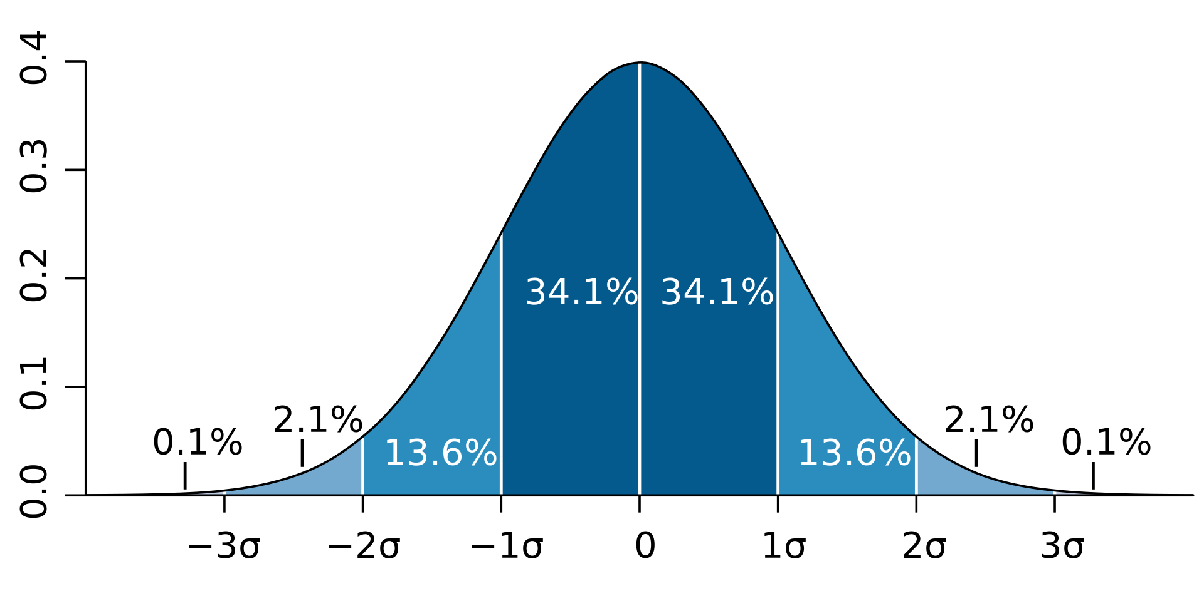

Normal distribution (4)
$$μ$$

Slide 8
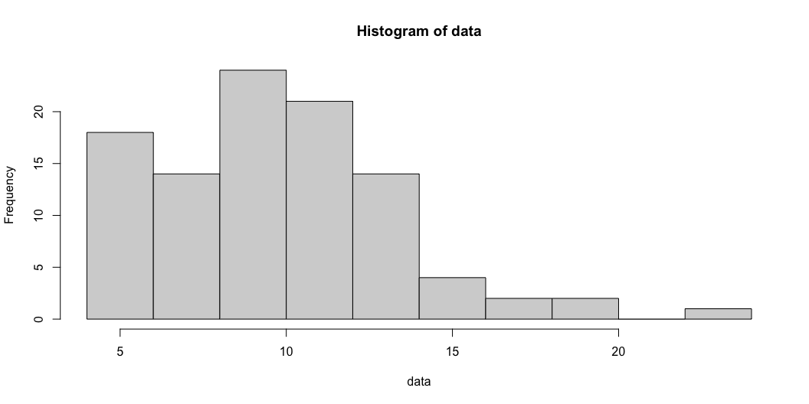
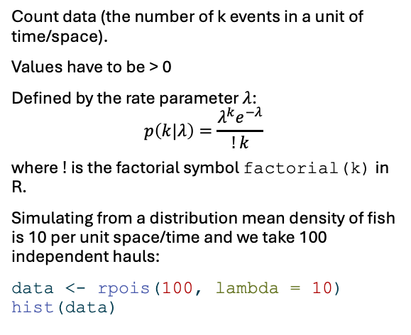
Poisson distribution (1)
Count data (the number of k events in a unit of time/space).
Values have to be > 0
Defined by the rate parameter $λ$:
$$p\left(k|λ\right)=\frac{λ^{k}e^{−λ}}{!k}$$
where $!$ is the factorial symbol factorial(k) in R.
Simulating from a distribution mean density of fish is 10 per unit space/time and we take 100 independent hauls:
data <- rpois(100, lambda = 10) hist(data)

Slide 9
Poisson distribution (2)
The probability of getting 14 fish is greater than the probability of getting 1.
dpois(1, 10)
[1] 0.0004539993
dpois(14, 10)
[1] 0.0520771

Slide 10
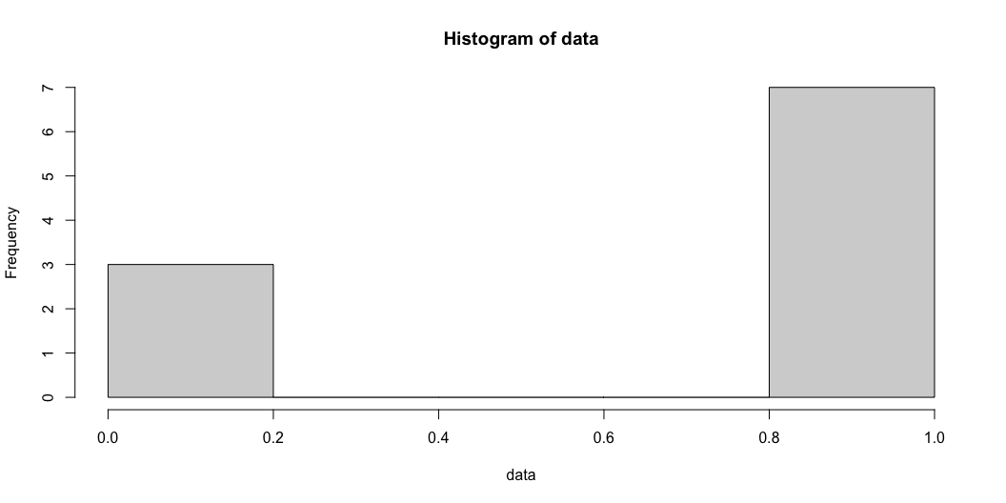
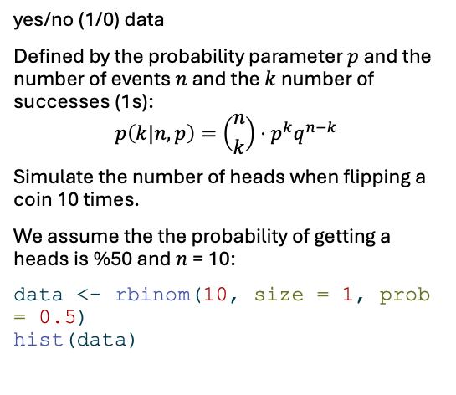
Binomial distribution (1)
yes/no (1/0) data
Defined by the probability parameter $p$ and the number of events $n$ and the $k$ number of successes (1s):
$$p\left(k|n,p\right)=\left({n \atop k}\right)⋅p^{k}q^{n−k}$$
Simulate the number of heads when flipping a coin 10 times.
We assume the the probability of getting a heads is %50 and $n$ = 10:
data <- rbinom(10, size = 1, prob = 0.5) hist(data)

Slide 11
Binomial distribution (2)
The probability of getting 1 heads is less than getting 7 heads:
dbinom(1, size = 10, prob = 0.5)
[1] 0.009765625
dbinom(7, size = 10, prob = 0.5)
[1] 0.1171875

Slide 12
Simulating data for a model

Slide 13
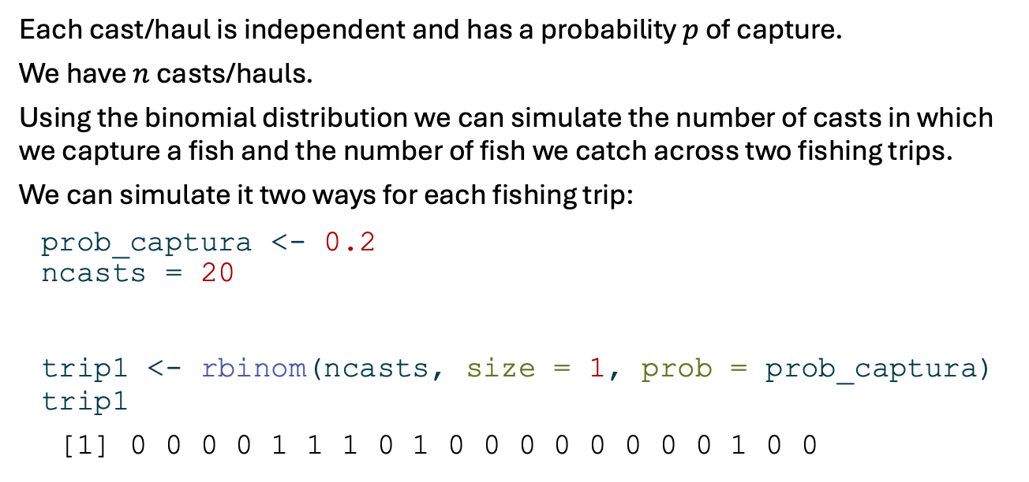
Probability of capture
Each cast/haul is independent and has a probability $p$ of capture.
We have $n$ casts/hauls.
Using the binomial distribution we can simulate the number of casts in which we capture a fish and the number of fish we catch across two fishing trips.
We can simulate it two ways for each fishing trip:
prob_captura <- 0.2 ncasts = 20 trip1 <- rbinom(ncasts, size = 1, prob = prob_captura) trip1
[1] 0 0 0 0 1 1 1 0 1 0 0 0 0 0 0 0 0 1 0 0

Slide 14
trip2 <- rbinom(1, size = ncasts, prob = prob_captura) trip2
[1] 2

Slide 15
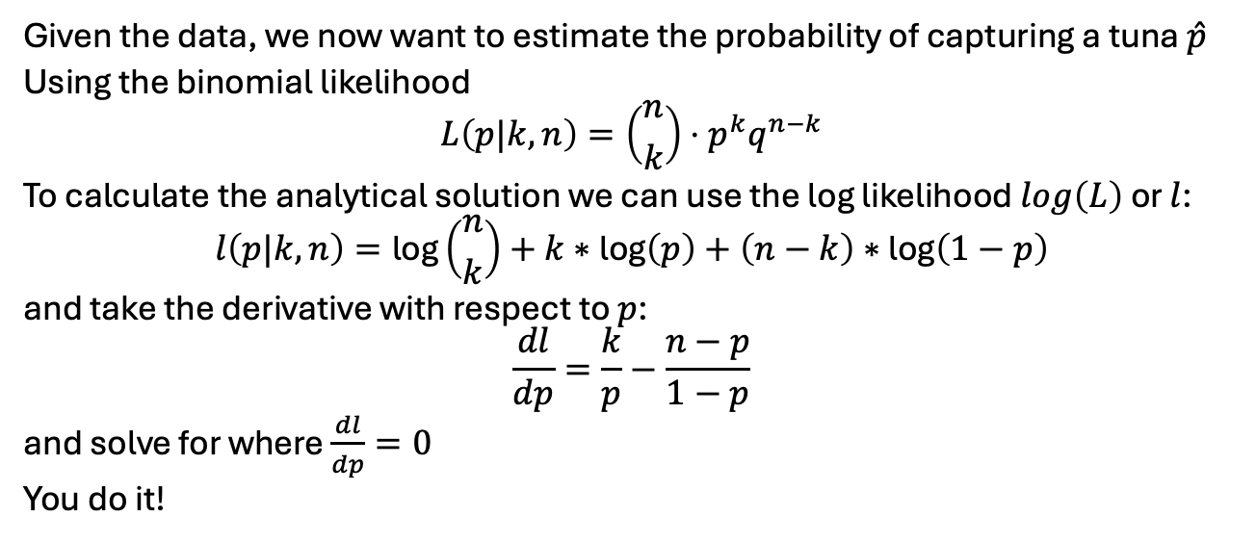
Estimation (analytic)
Given the data, we now want to estimate the probability of capturing a tuna $\hat{p}$
Using the binomial likelihood
$$L\left(p|k,n\right)=\left({n \atop k}\right)⋅p^{k}q^{n−k}$$
To calculate the analytical solution we can use the log likelihood $log\left(L\right)$ or $l$:
$$l\left(p|k,n\right)=\text{log}\left({n \atop k}\right)+k∗\text{log}\left(p\right)+\left(n−k\right)∗\text{log}\left(1−p\right)$$
and take the derivative with respect to $p$:
$$\frac{dl}{dp}=\frac{k}{p}−\frac{n−p}{1−p}$$
and solve for where $\frac{dl}{dp}=0$
You do it!

Slide 16
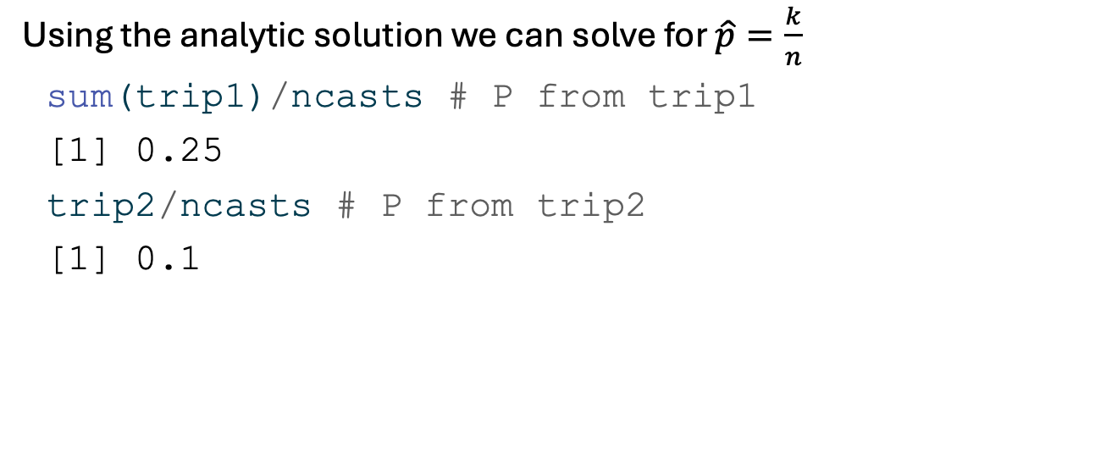
Using the analytic solution we can solve for $\hat{p}=\frac{k}{n}$
sum(trip1)/ncasts # P from trip1
[1] 0.25
trip2/ncasts # P from trip2
[1] 0.1

Slide 17
Estimation (analytic)
or combine because they are independent
(sum(trip1)+trip2)/(ncasts * 2) # P from both trips
[1] 0.175

Slide 18
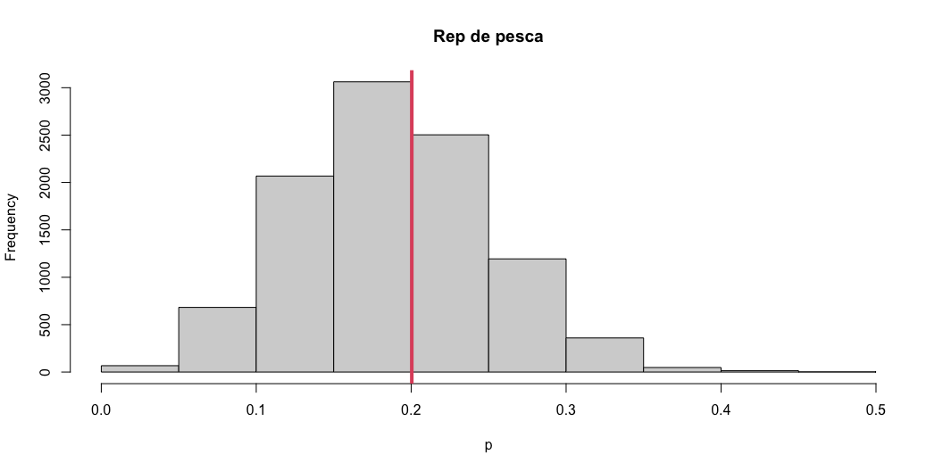
Repeated sampling
Repeat the sampling from two trips 10,000 times
data <- data.frame(rep = 1:10000, Tuna = NA, P = NA) for(rep in 1:nrow(data)){ data$Tuna[rep] = rbinom(1, size = (ncasts*2), prob = prob_captura) data$P[rep] = data$Tuna[rep]/(ncasts*2) } hist(data$P, breaks = 15, xlab = "p", main = "Rep de pesca") abline(v = mean(data$P), col = 2, lwd = 4)

Slide 19
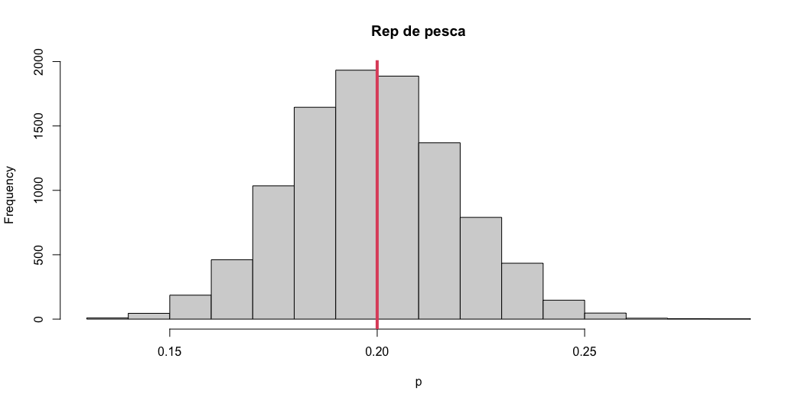
Repeated and better sampling
Repeat the above 10,000 times, but increase the number of casts to 200
data <- data.frame(rep = 1:10000, Tuna = NA, P = NA) ncasts_mas = 200 for(rep in 1:nrow(data)){ data$Tuna[rep] = rbinom(1, size = (ncasts_mas*2), prob = prob_captura) data$P[rep] = data$Tuna[rep]/(ncasts_mas*2) } hist(data$P, breaks = 15, xlab = "p", main = "Rep de pesca") abline(v = mean(data$P), col = 2, lwd = 4)

Slide 20
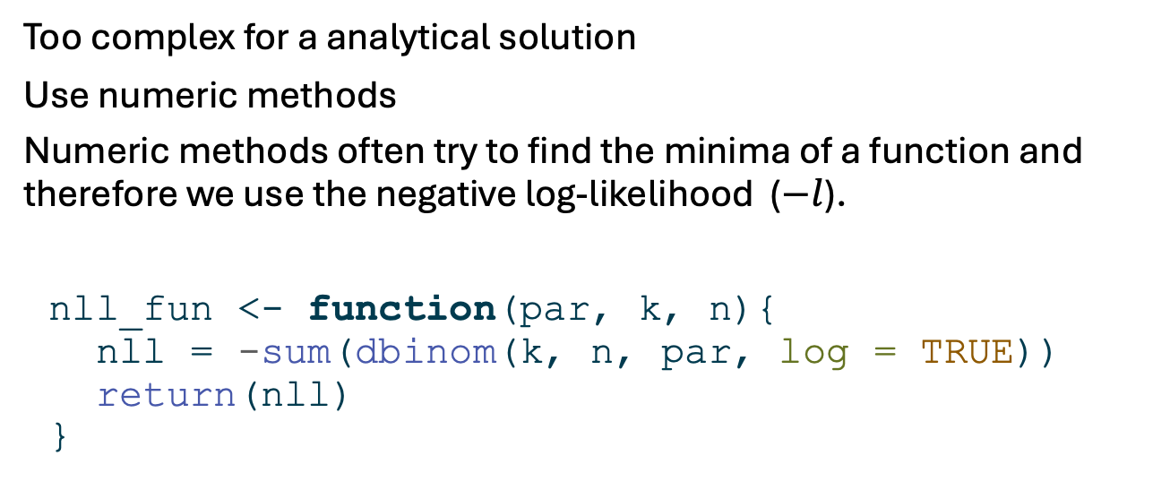
Numerical estimation (1)
Too complex for a analytical solution
Use numeric methods
Numeric methods often try to find the minima of a function and therefore we use the negative log-likelihood ($−l$).
nll_fun <- function(par, k, n){ nll = -sum(dbinom(k, n, par, log = TRUE)) return(nll) }

Slide 21
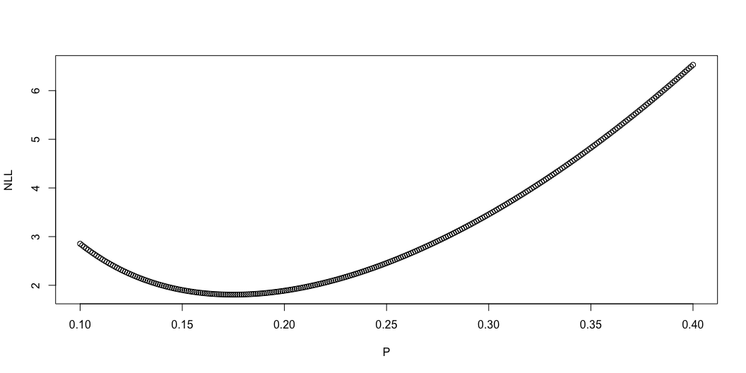
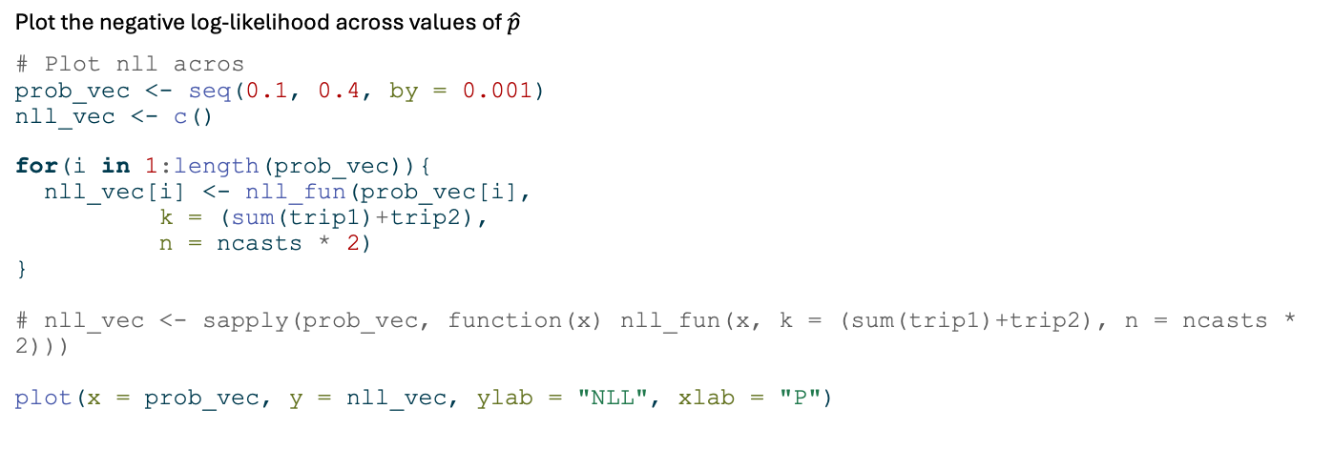
Numerical estimation (2)
Plot the negative log-likelihood across values of $\hat{p}$
# Plot nll acros prob_vec <- seq(0.1, 0.4, by = 0.001) nll_vec <- c() for(i in 1:length(prob_vec)){ nll_vec[i] <- nll_fun(prob_vec[i], k = (sum(trip1)+trip2), n = ncasts * 2) } # nll_vec <- sapply(prob_vec, function(x) nll_fun(x, k = (sum(trip1)+trip2), n = ncasts * 2))) plot(x = prob_vec, y = nll_vec, ylab = "NLL", xlab = "P")

Slide 22
Numerical estimation (3)
Use the function optim to find the MLE
opt <- optim(par = 0.1, fn = nll_fun, k = (sum(trip1)+trip2), n = (ncasts * 2), method = "Brent", lower = 0, upper = 1) opt$par
[1] 0.175

